Slide 1
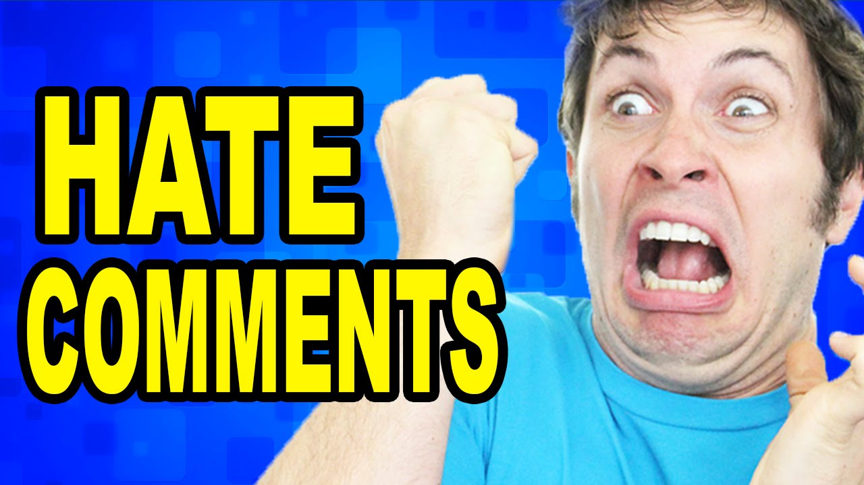
Presentation on Malignant Comments Classifier
Submitted by-
Sankalp Mahapatra
Internship 29

Slide 2
TABLE OF CONTENTS
INTRODUCTION
Business Problem Framing
Business goal
Motivation for the Problem undertaken
Exploratory Data Analysis (EDA)
Data Visualization
Model/s Development and Evaluation
Hyperparameter tuning using GridSearchCV
Conclusion

Slide 3
INTRODUCTION
Over the years, social media and social networking use have been increasing exponentially due to an upsurge in the use of the internet. Flood of information arises from online conversation in a daily basis as people are able discuss, express themselves and air their opinion via these platforms.
Every day, we get a tremendous amount of short content data from the blast of online correspondence, web-based business and the utilization of advanced gadgets. This volume of data requires text mining apparatuses to carry out the various report tasks in an opportune and suitable way. Detecting and controlling verbal abuse in an automated fashion is inherently an NLP task (Natural Language Processing). Text Classification is a great point for NLP.
Nowadays, every social media site and applications use machine learning approach. Machine Learning has simplified the task that may take long duration to complete without it. Most of the approaches require text analysis and classification techniques. Classification of the comments is necessary before posting on online platforms. This paper discusses different methodologies like logistic regression, support vector machine, multinomial naïve bayes etc. for comment classification into 6 different categories viz. malignant, highly malignant, rude, threat, abuse and loathe.

Slide 4
Business Problem Framing
Social media has given a lot of people which beyond imagination. In this era of technology, it has become the hub of information. The numbers of contents on social media are vast and rich and everything has found a place on social media that may be anything. It has given wings to its users to fly high and express their feelings. It has become a boon for the mankind but we all know that if there is good there must be bad. Likewise, social media has also got the dark side.
The proliferation of social media enables people to express their opinions widely online. However, at the same time, this has resulted in the emergence of conflict and hate, making online environments uninviting for users. Although researchers have found that hate is a problem across multiple platforms, there is a lack of models for online hate detection. Online hate, described as abusive language, aggression, cyberbullying, hatefulness and many others has been identified as a major threat on online social media platforms.

Slide 5
Social media platforms are the most prominent grounds for such toxic behaviour. There has been a remarkable increase in the cases of cyberbullying and trolls on various social media platforms. Many celebrities and influences are facing backlashes from people and have to come across hateful and offensive comments. This can take a toll on anyone and affect them mentally leading to depression, mental illness, self-hatred and suicidal thoughts.
Internet comments are bastions of hatred and vitriol. While online anonymity has provided a new outlet for aggression and hate speech, machine learning can be used to fight it. The problem we sought to solve was the tagging of internet comments that are aggressive towards other users. This means that insults to third parties such as celebrities will be tagged as unoffensive, but “u are an idiot” is clearly offensive.

Slide 6
Conceptual Background of the Domain Problem
In the past few years, it is seen that the cases related to social media hatred have increased exponentially. The social media is turning into a dark venomous pit for people now a days. Online hate is the result of difference in opinion, race, religion, occupation, nationality etc. In social media the people spreading or involved in such kind of activities uses filthy languages, aggression, images etc. to offend and gravely hurt the person on the other side. This is one of the major concerns now.
The result of such activities can be dangerous. It gives mental trauma to the victims making their lives miserable. People who are not well aware of mental health online hate or cyberbullying become life threatening for them. Such cases are also at rise. It is also taking its toll on religions. Each and every day we can see an incident of fighting between people of different communities or religions due to offensive social media posts.
Online hate, described as abusive language, aggression, cyberbullying, hatefulness, insults, personal attacks, provocation, racism, sexism, threats, or toxicity has been identified as a major threat on online social media platforms. These kinds of activities must be checked for a better future.

Slide 7
Motivation for the Problem Undertaken
The main objective of this study is to investigate which method from a chosen set of machine learning techniques performs the best. So far, we have a range of publicly available models served through the Perspective API, including toxicity/malignant comments. But the current models still make errors, and they don’t allow users to select which type of toxicity they are interested in finding.
The project which is given by Flip ROBO as a part of the internship programme which gives an insight to identify major factors that lead to cyberbullying and online abusive comments. The exposure to real world data and the opportunity to deploy my skillset in solving a real time problem has been the primary objective. However, the motivation for taking this project was that it is relatively a new field of research. Here we have many options but less concrete solutions. The main motivation was to classify the news in order to bring awareness and reduce unwanted chaos and make a good model which will help us to know such kind of miscreants. Our goal is to build a prototype of online hate and abuse comment classifier which can used to classify hate and offensive comments so that it can be controlled and restricted from spreading hatred and cyberbullying.

Slide 8
Exploratory Data Analysis (EDA)
Importing necessary libraries and loading dataset as a data frame.
Checked some statistical information like shape, number of unique values present, info, null values, value counts, duplicated values etc.
Checked for null values and did not find any null values. And removed Id.
Done feature engineering and created new columns viz label: which contain both good and bad comments which is the sum of all the labels, comment_length: which contains the length of comment text.
Visualized each feature using seaborn and matplotlib libraries by plotting categorical plots like pie plot, count plot, distribution plot and wordcloud for each label.

Slide 9
Done text pre-processing techniques like Removing Punctuations and other special characters, Splitting the comments into individual words, Removing Stop Words, Stemming and Lemmatization.
Then created new column as clean_length after cleaning the data. All these steps were done on both train and test datasets. Checked correlation using heatmap.
After getting a cleaned data used TF-IDF vectorizer. It’ll help to transform the text data to feature vector which can be used as input in our modelling. It is a common algorithm to transform text into numbers. It measures the originality of a word by comparing the frequency of appearance of a word in a document with the number of documents the words appear in.
Balanced the data using Randomoversampler method.

Slide 10
Data Visualization
I used pandas profiling to get the over viewed visualization on the pre-processed data.
Pandas is an open-source Python module with which we can do an exploratory data analysis to get detailed description of the features and it helps in visualizing and understanding the distribution of each variable.
I have used wordcloud to get the sense of loud words in the labels.

Slide 11
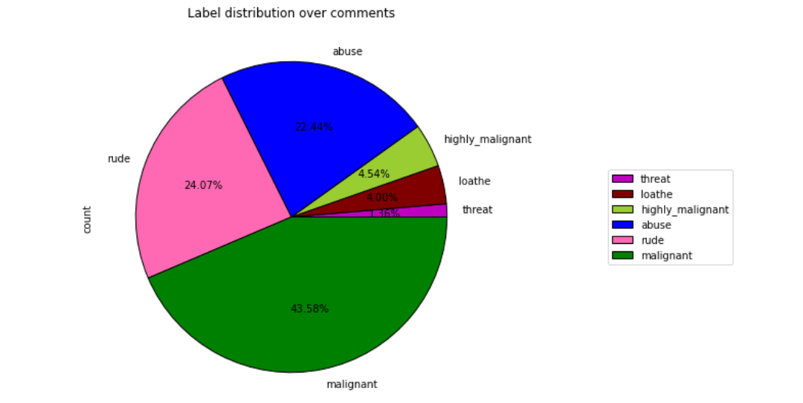

Slide 12
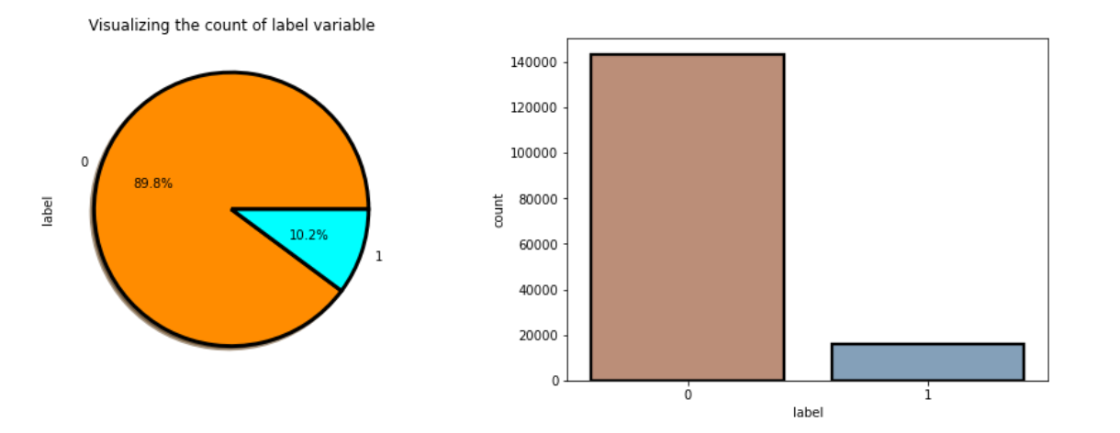
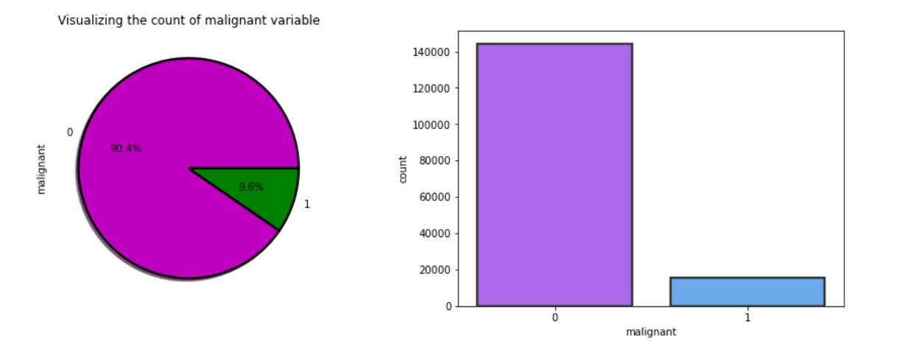

Slide 13
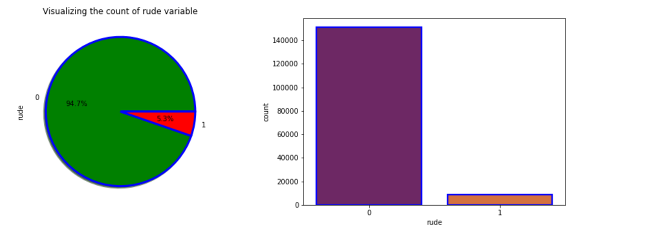
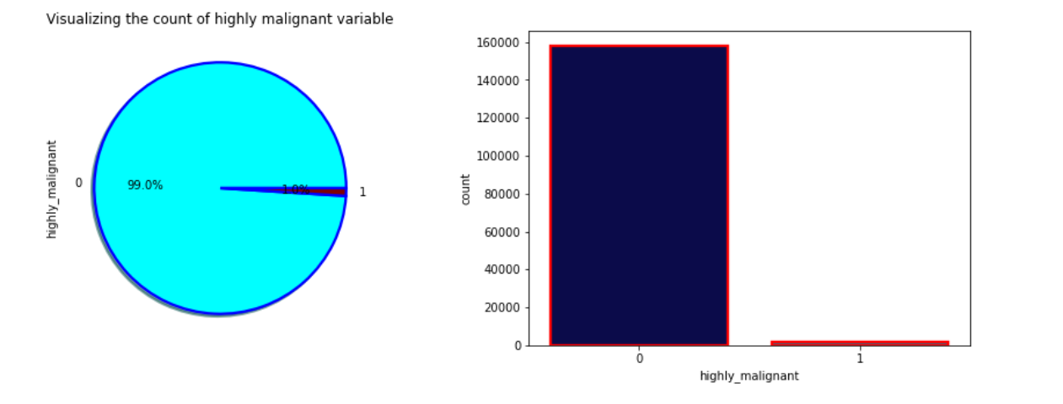

Slide 14
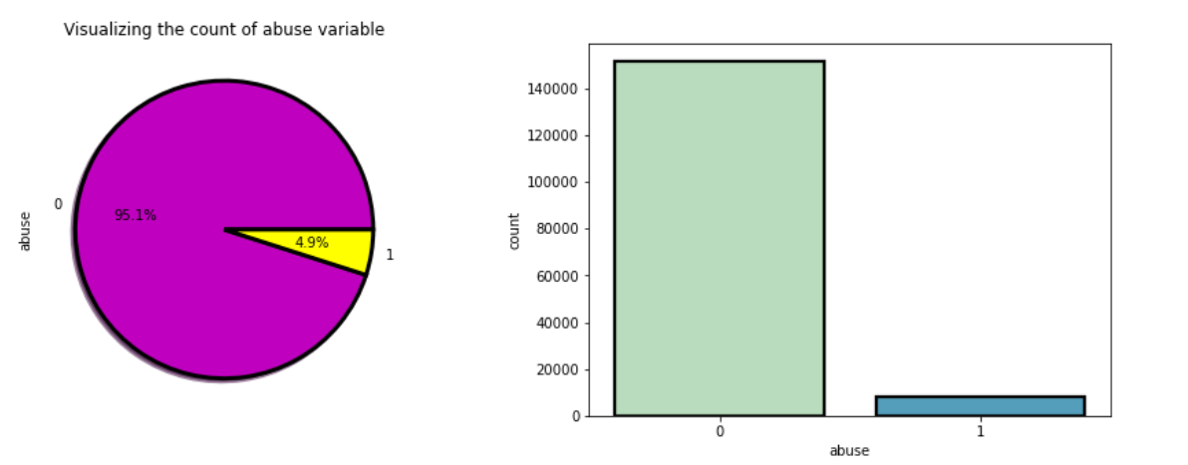
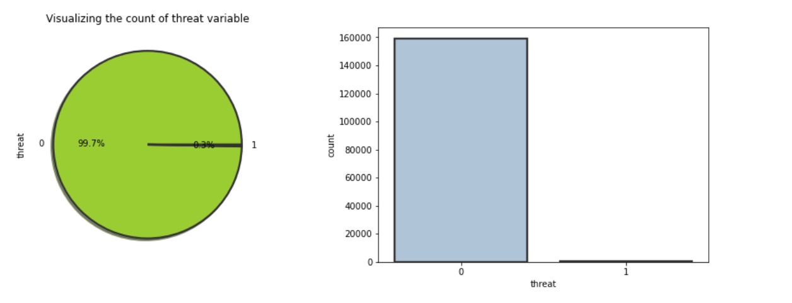

Slide 15
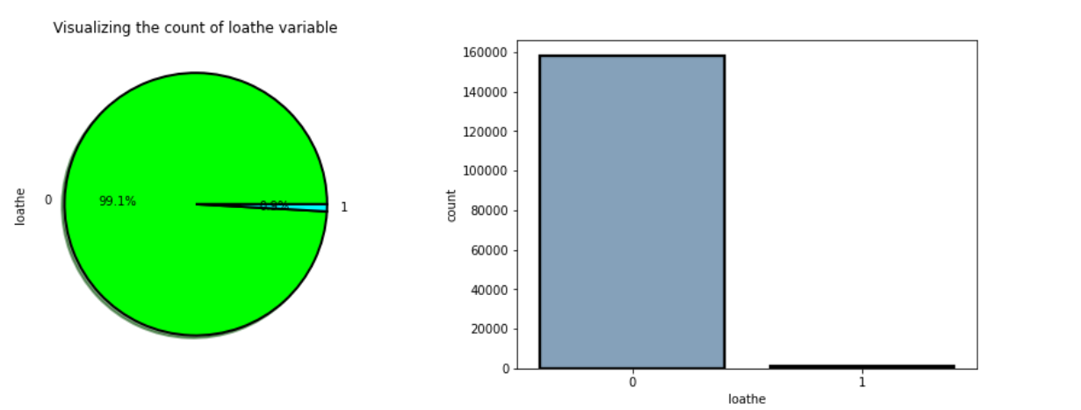

Slide 16
Observations from the count plots and Pie plots
From the pie chart we can notice approximately 43% of the comments are malignant, 24% of the comments are rude and 22% are abuse. The count of malignant comments are high compared to other type of comments and the count of threat comments are very less.
From the above plots we can observe the count of negative comments are high compared to the non negative comments. Here around 90% of the comments are turned out to be a negative comments and only 10% of them are considered to be positive or neutral comments. We can also observe the data imbalance issue here, we need to balance the data.
From the above plots we can observe the count of malignant comments are high compared to non malignant comments. That is around 90% of the comments are malignant and only 9.6% of the comments are good.

Slide 17
From the plot we can observe the count of highly malignant comments are very high which is about 99% and only 1% of the comments are normal.
The count of rude comments are high compared to normal comments. Around 94% of the comments are falls down into rude and remaining considered to be normal comments.
Here also 99.7% of the comments are threat and only 0.3% of the comments are look normal.
The count of abusing type comments are high which has 95.1% and only 4.9% of the comments are normal.
The count of loathe is high compared to normal text comments.

Slide 18
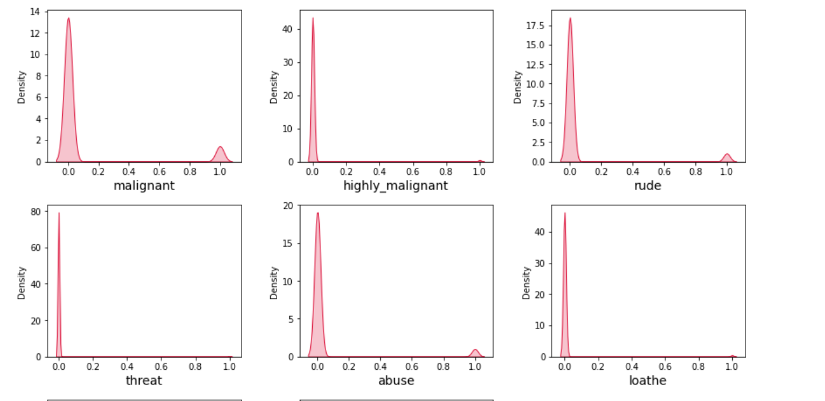
Visualization of the type of distribution for each feature

Slide 19
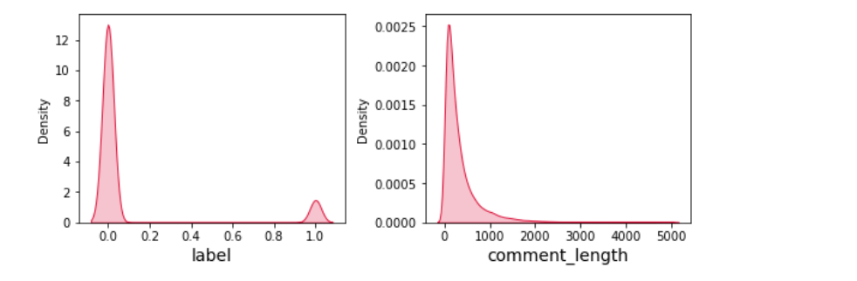
Observations from the dist plots
From the distribution plots we can notice that all the columns are skewed to right except comment_label column. Since all the columns are categorical in nature there is no need to remove skewness and outliers in any of the columns.

Slide 20
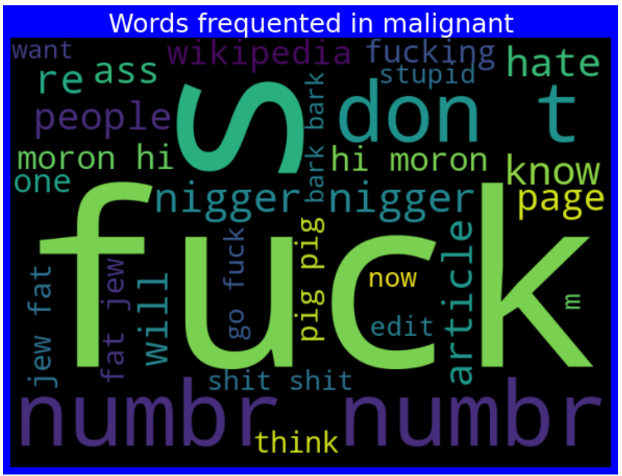
Plotting WordCloud for each label

Slide 21
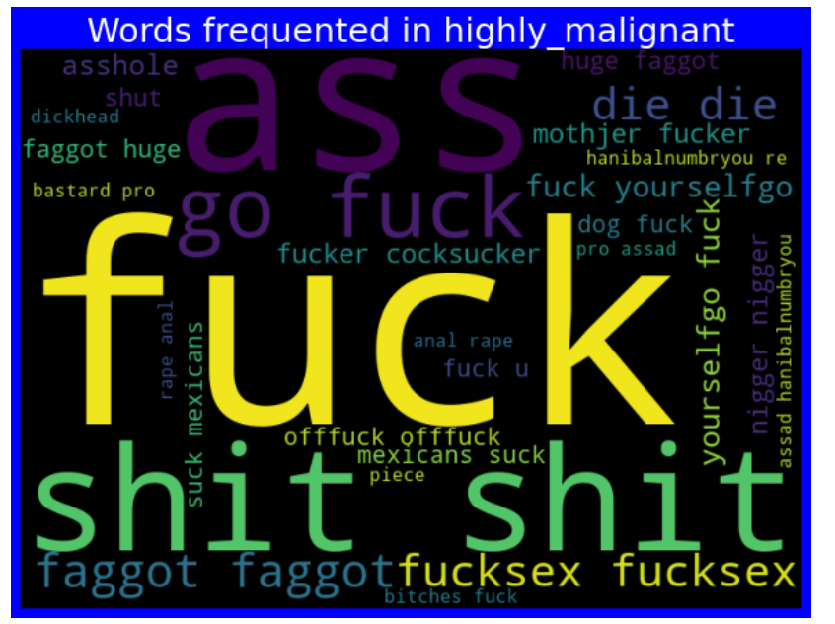

Slide 22
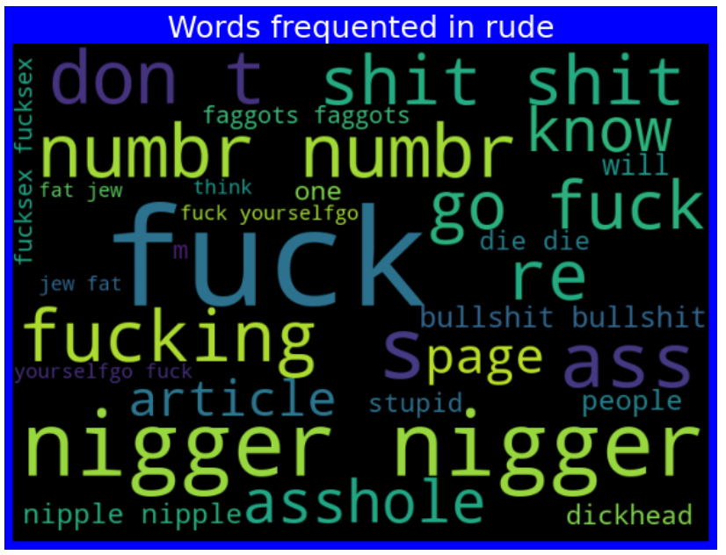

Slide 23
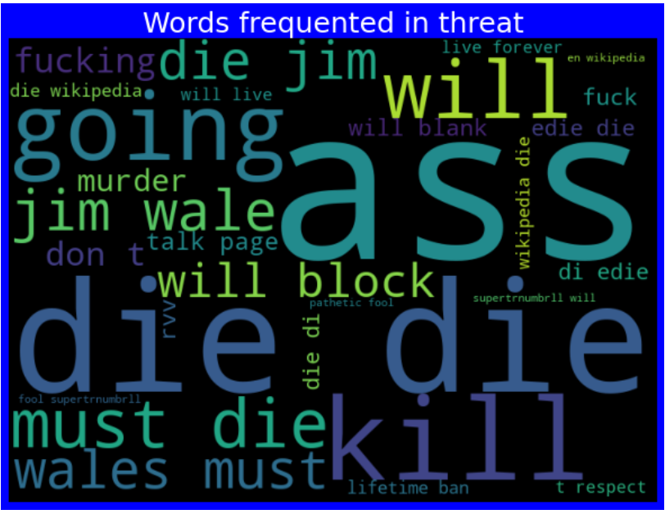

Slide 24
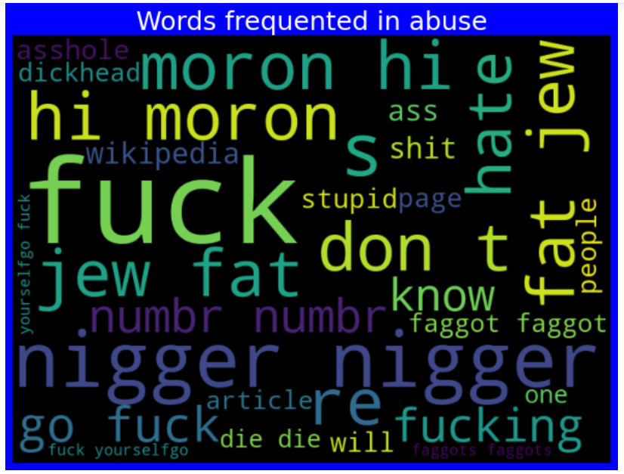

Slide 25
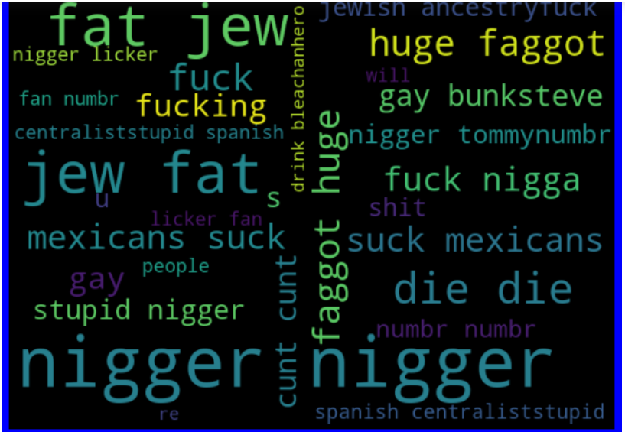

Slide 26
Observations from the word cloud
From the above plots we can clearly see the toxic words which are indication of malignant, highly malignant, rude, threat, abuse and loathe words.
Here most frequent words used for each label is displayed in the word cloud based on different label and also when all the values are present.

Slide 27
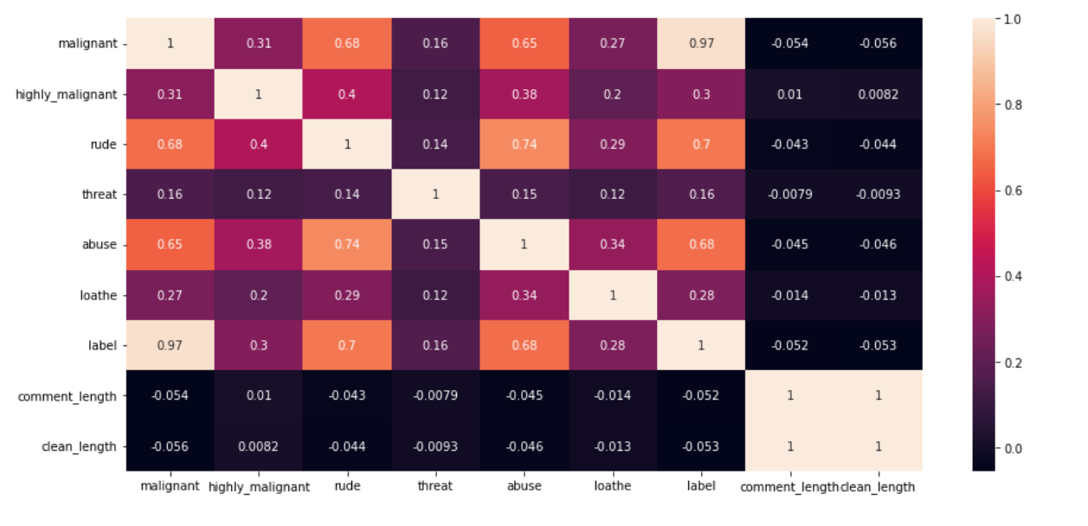
Plotting heatmap plot to find out the correlation among the features and label and multi-corlinearity

Slide 28
Observations from the Heatmap Plot
From the heat map we can observe the features have some strong relation with each other. We can also observe multicorllinearity problem.

Slide 29
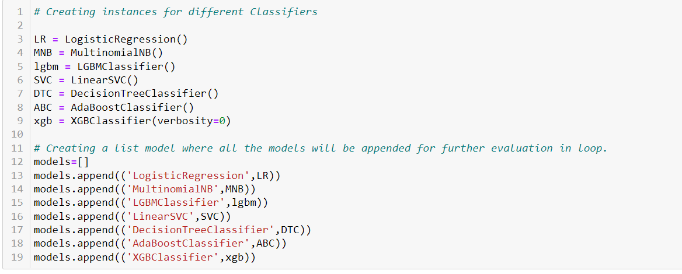
Model/s Development and Evaluation
I have used 7 classification algorithms. First, I have created 7 different classification algorithms and are appended in the variable models. Then, ran a for loop which contained the accuracy of the models along with different evaluation metrics.

Slide 30
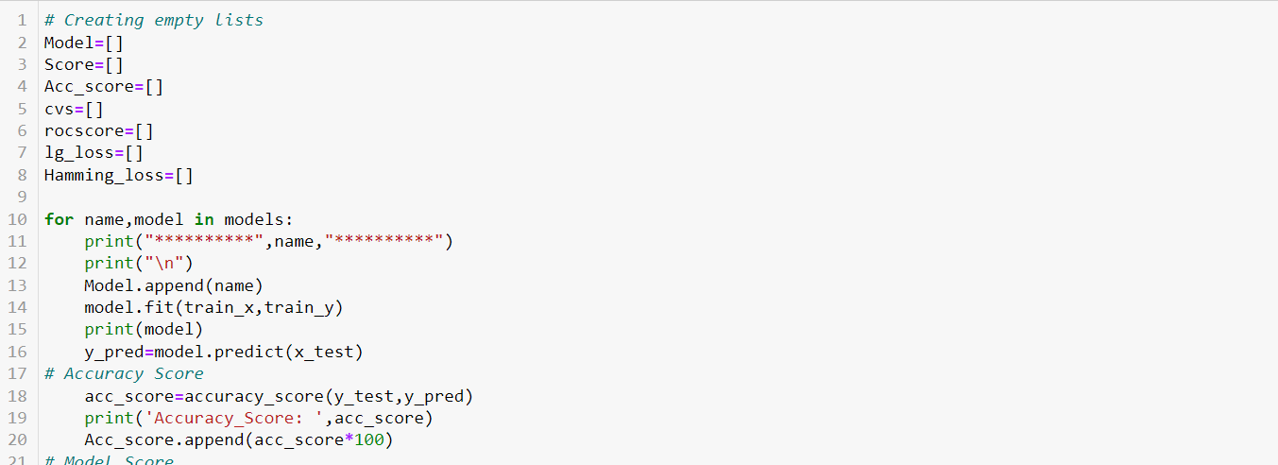
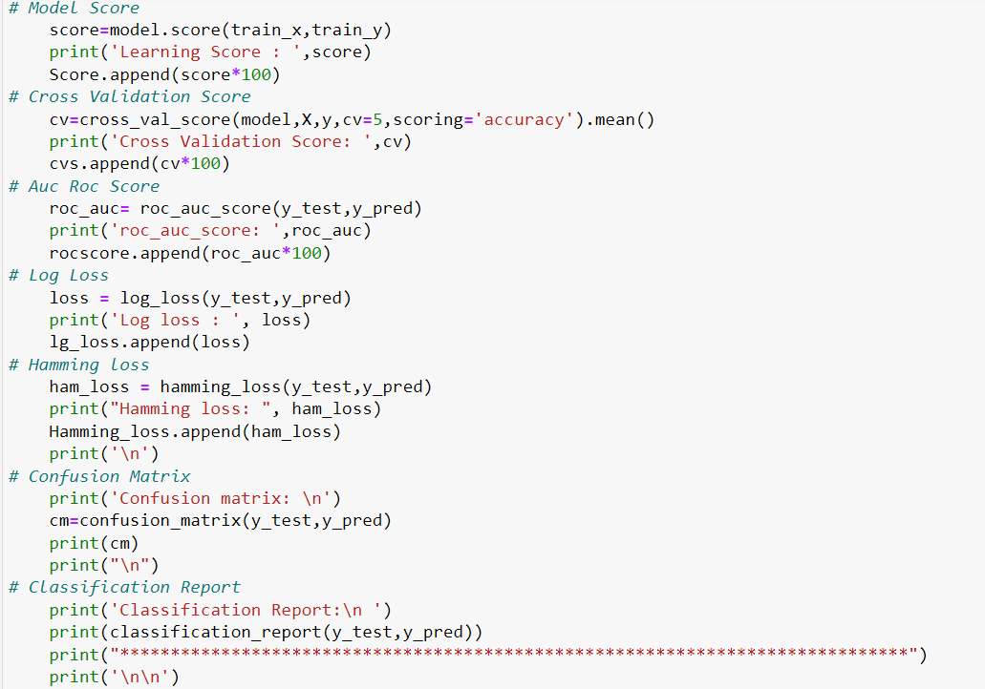

Slide 31
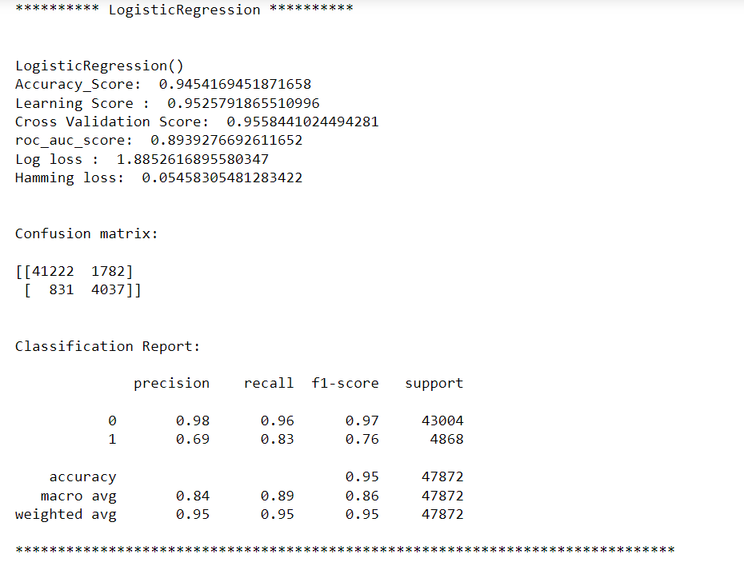
Logistic Regression

Slide 32
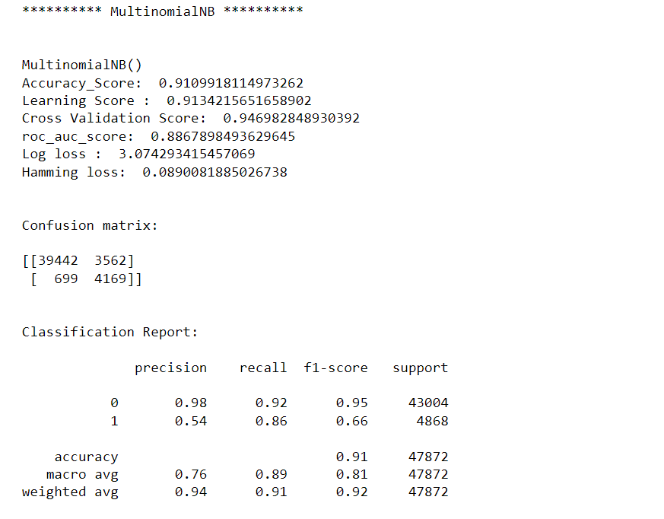
MultinomialNB

Slide 33
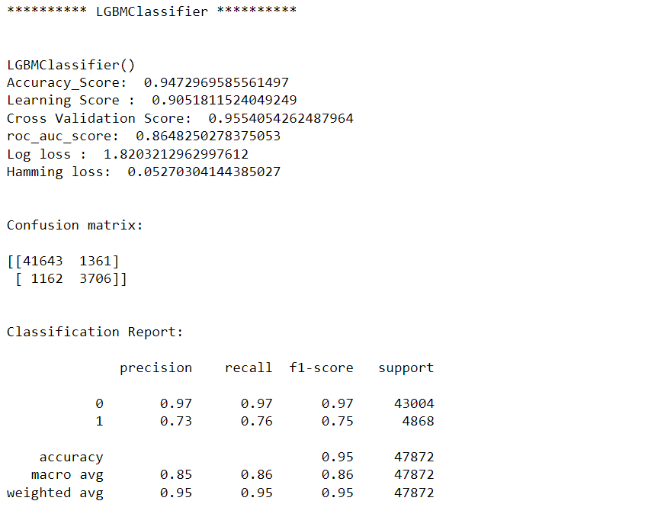
LGBMC Classifier

Slide 34
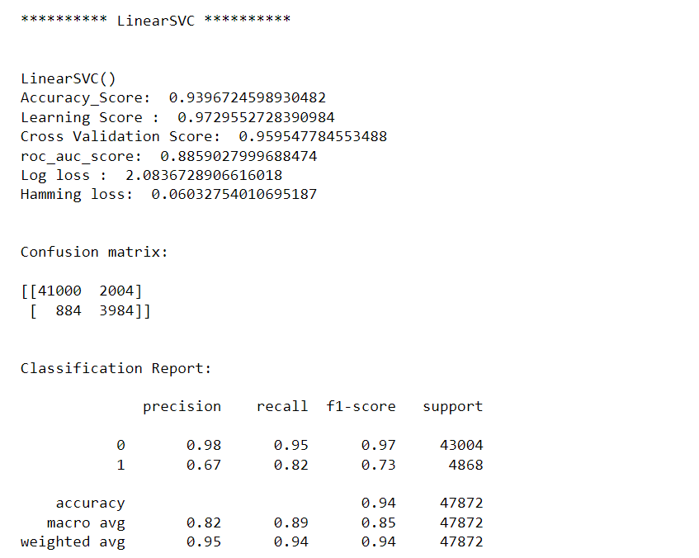
Linear SVC

Slide 35
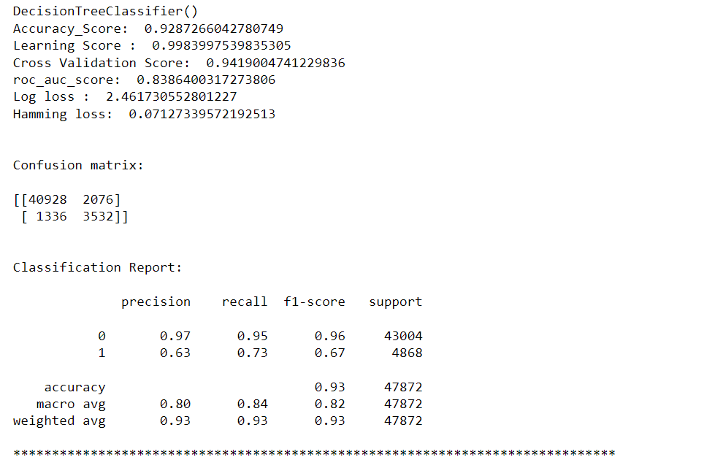
Decision Tree Classifier

Slide 36
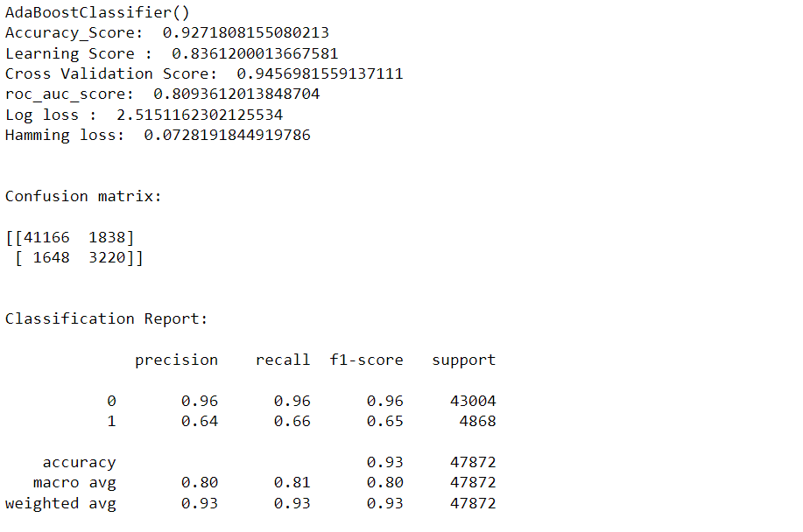
AdaBoost Classifier

Slide 37
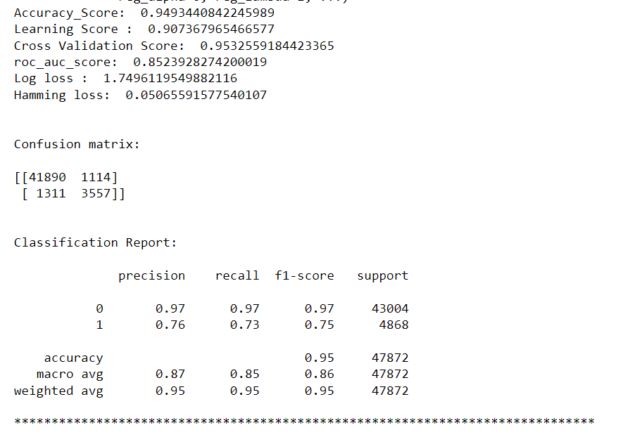
XGB Classifier

Slide 38
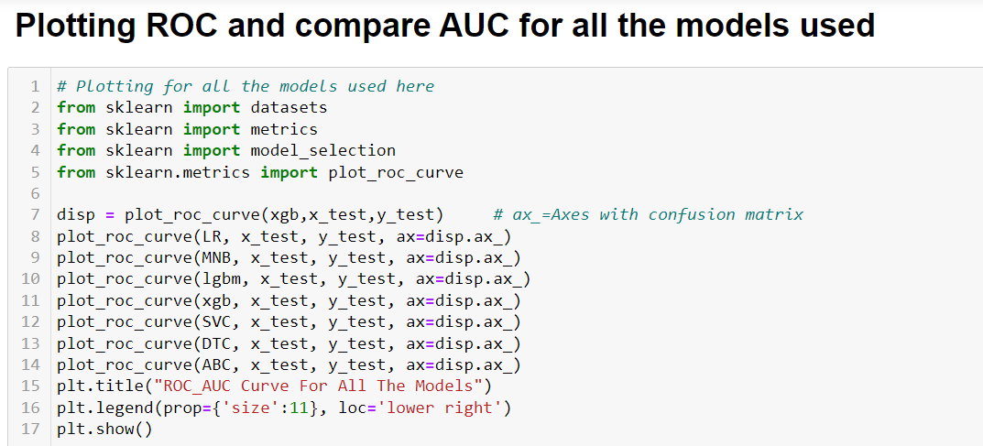
ROC AUC curve

Slide 39
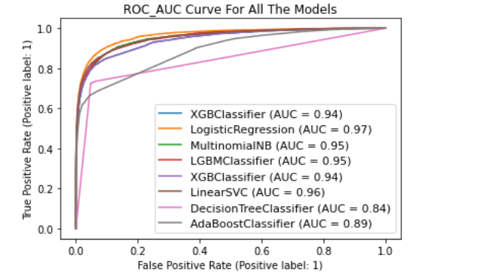

Slide 40
Model Selection
After creating and training different classification algorithms, we can see that the difference between accuracy and cross validation score is less for "Extreme Gradient Boosting Classifier (XGBClassifier)" and Gradient Boosting Classifier. But, XGBClassifier giving less loss values, auc roc score and high accuracy score compared to Gradient Boosting Classifier. On this basis I can conclude that "XGBClassifier" as the best fitting model. Now, we will try Hyperparameter Tuning to find out the best parameters and using them to improve the scores and metrics values.

Slide 41
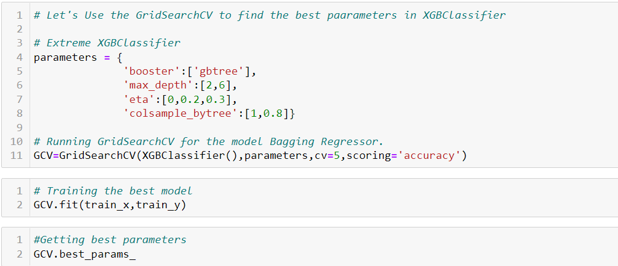
Hyperparameter tuning using GridSearchCV

Slide 42
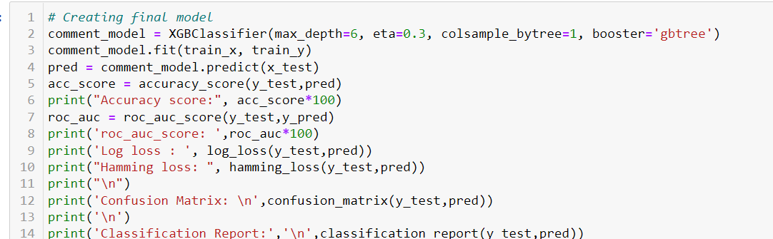

Slide 43
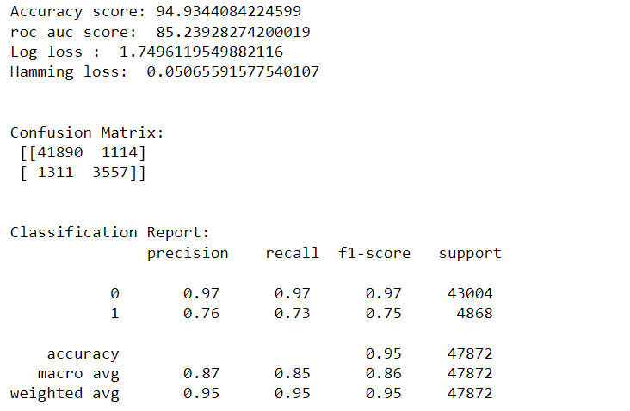

Slide 44
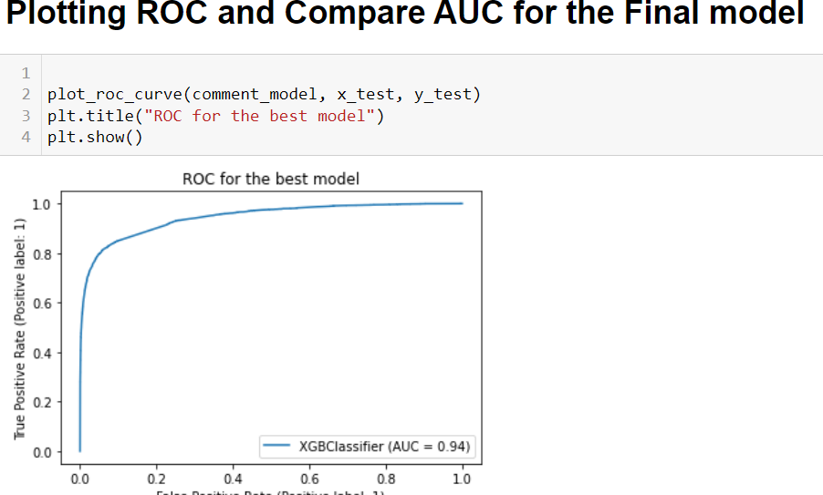

Slide 45
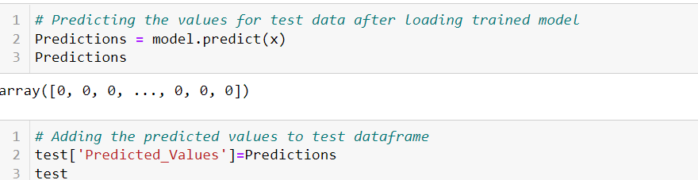
Predicting label using our best model.

Slide 46
Conclusion
From the above analysis the below mentioned results were achieved which depicts the chances and conditions of a comment being a hateful comment or a normal comment;
With the increasing popularity of social media more and more people consume feeds from social media and due differences they spread hate comments to instead of love and harmony. It has strong negative impacts on individual users and broader society.
In training dataset, we have only 10% of data which is spreading hate on social media.

Slide 47
In this 10% data most of the comments are malignant, rude or abuse.
After using the wordcloud we find that there are so many abusive words present in the negative comments. While in positive comments there is no use of such comments.
Some of the comments are very long while some are very short

